Slide 1
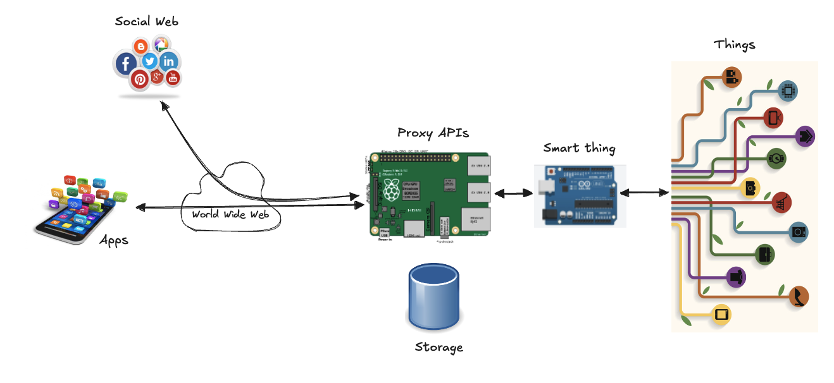
Edge Devices

Slide 2
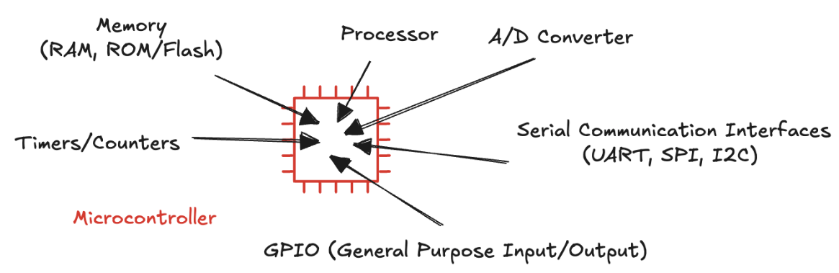
Edge Device
A computing unit located at or near the point where data is generated
Faster data processing
Minimizes latency (real-time responses)
Core component: microcontroller
Compact, specialized integrated circuit designed to handle specific tasks
Integrate a processor core, memory, input/output peripherals on a single chip
Ideal for lightweight, task-focused operations:

Slide 3
Microcontroller vs Microprocessor
Microcontroller: a self-contained system designed to perform specific tasks efficiently and repeatedly
High level of integration: compact, cost-effective, and energy-efficient
Performing a single dedicated function (controlling a microwave, thermostat)
Run one program stored in ROM, repeating it consistently without change
Microprocessor: a central processing unit (CPU) and lacks integrated components like memory and I/O peripherals
External modules such as RAM, ROM, storage, and I/O controllers
More versatile but also more complex
Flexibility and able to handle large, multifaceted programs, such as personal computers, servers, or gaming consoles
The distinction is becoming less clear
Advanced processors like ARM-based systems (e.g., 32-bit Cortex-M series)
Features of both: simplicity with power
Hybrid systems used in applications that demand real-time processing and computational power (smartphones)

Slide 4
Development Board
A ready-to-use platform
Microcontroller provides essential computing capabilities
We typically requires additional components and configurations
leds, buttons, voltage regulators, and sometimes even displays, sensors and communication modules
To allow developers to focus on the application logic rather than building basic hardware
Supported by software development environments and libraries
Examples:
Arduino boards: https://www.arduino.cc/
come with a large collection of libraries for various hardware components
STM32 development boards https://www.st.com/en/microcontrollers-microprocessors/stm32-32-bit-arm-cortex-mcus.html
are supported by software tools, easing the configuration of peripherals

Slide 5
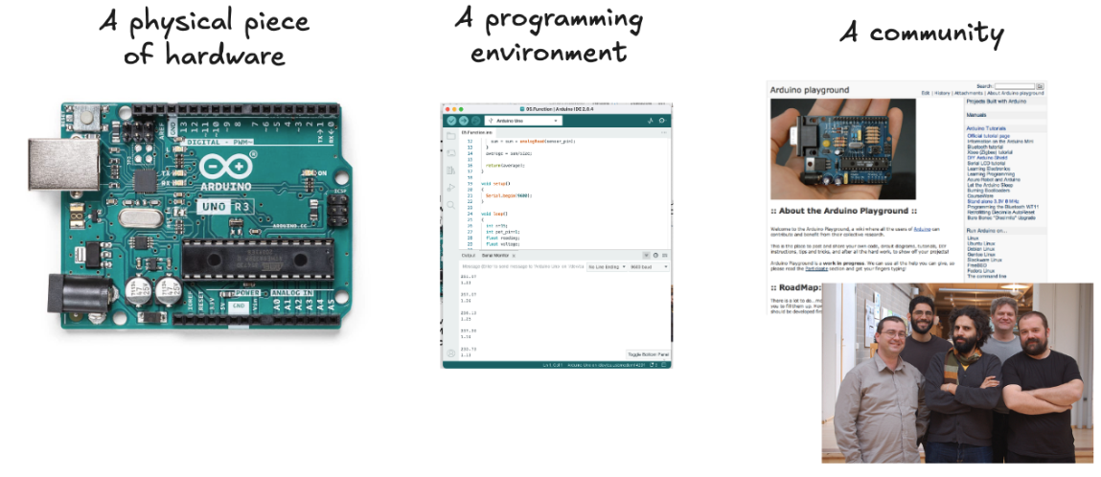
Arduino
Open-source electronic platform
Accessible and easy-to-use hardware and software for creating electronic projects
Introduced in 2005 at the Interaction Design Institute in Italy,
User-friendly tool for students exploring electronics.

Slide 6
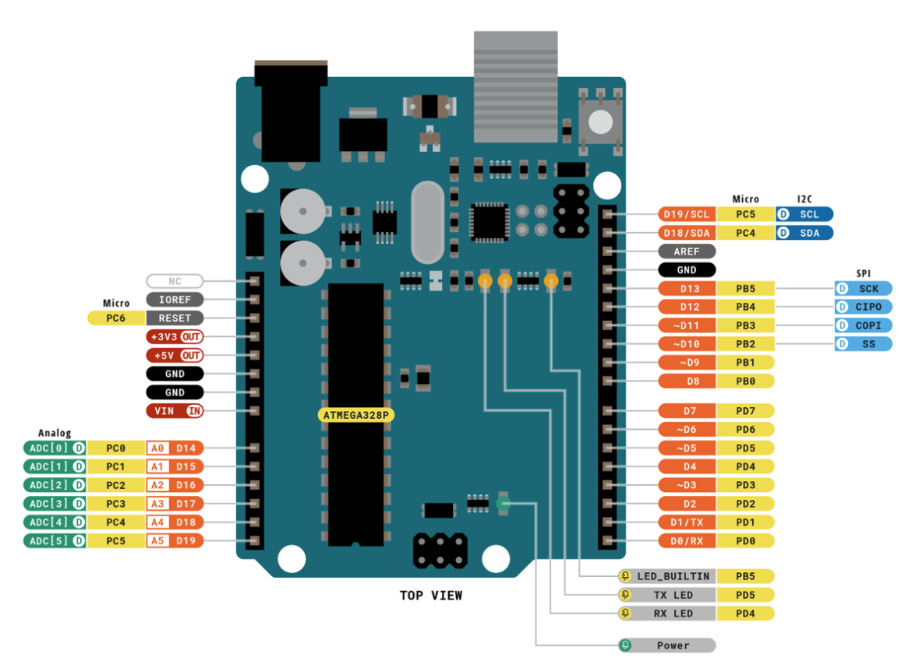
Arduino Uno Board

Slide 7
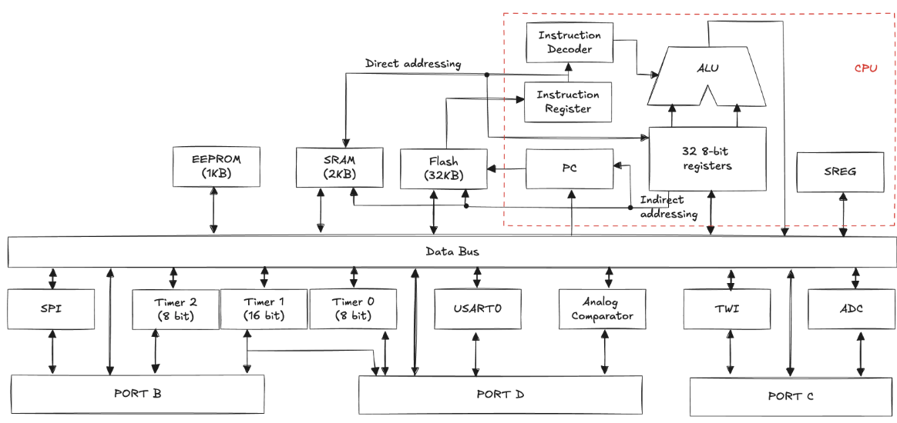
ATMEL ATmega328P microcontroller

Slide 8
Embedded Programming
Standard programming involves developing software for general-purpose computers that have abundant resources (processing, memory, storage)
Performance, usability, and maintainability are the primary concerns
Use of high-level programming languages and powerful development environments
Run on operating systems (memory management, device drivers)
Embedded programming is focused on writing software for hardware with limited resources
Run on a bare-metal setup (no OS) or lightweight operating systems
Careful management of hardware resources
Debugging is challenging because tools for monitoring may be limited,
Minimal or no UIs, interaction is through leds, buttons, or small displays
Communication occurs via network protocols or serial communication
Key difference: embedded programming prioritizes resource constraints, real-time and direct hardware interfacing, while standard programming focuses on performance and UX for general-purpose computing

Slide 9
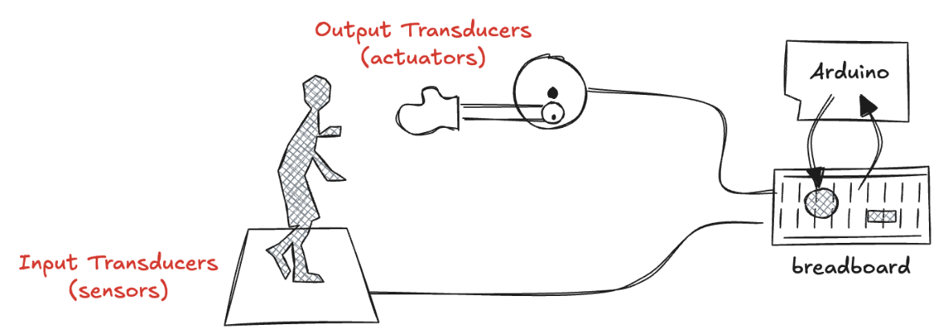
Physical computing (1)
An interactive system that integrates hardware and software to enable devices to sense and respond to the physical environment:
It incorporates some form of output to respond to the inputs it receives, making interaction with the physical world possible
Inputs: signals received by the board (buttons, switches, sensors, etc..)
Outputs: signals that leave the board, driving actions (lighting up LEDs, controlling motors, etc).

Slide 10
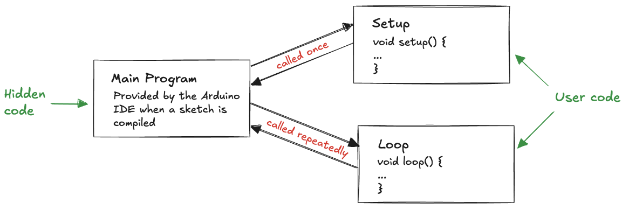
Physical computing (2)
Design the circuit
Determine electrical requirements of sensors or actuators (voltage, current, and power requirements of each component)
Identify analog inputs (sensors that provide variable signals)
Identify digital inputs (buttons or switches) and outputs (LEDs or motors)
Plan how each component will connect to the microcontroller, ensuring that each part of the circuit is properly powered and grounded
Writing the code: the core consists of two functions:
setup() runs once when the program starts and is used to initialize settings (pin modes, serial communication)
loop() runs continuously after setup() and contains the main logic of the program, repeating over and over

Slide 11
Controlling input and output
pinMode() is used to configure a pin behavior
specifying whether it acts as an input (to read data) or an output (to send data)
Digital pins:
digitalWrite() sets an output pin to HIGH (providing +5V, which can turn on a LED or activate a device) or LOW (0V, turning a device off)
digitalRead() can detect the state of an input pin, determining whether it is receiving a HIGH or LOW signal
Analog pins:
analogRead() reads the voltage from an analog pin as a value ranging from 0 (0V) to 1023 (5V), enabling the measurement of varying signals like those from a potentiometer or a sensor
To simulate an analog output, the analogWrite() generates a pulse-width modulation (PWM) signal (alternates between HIGH and LOW rapidly, creating the illusion of varying voltage levels)

Slide 12
Timing
Essential for controlling the flow of a program.
delay() pauses the execution of the program for a specified number of milliseconds
Useful for simple timing tasks, such as blinking a led or waiting between actions.
It blocks all other code execution during the pause, it can limit the responsiveness
millis() returns the number of milliseconds that have elapsed since the program started running
For precise and non-blocking timing
By comparing the current value of millis() with a previously recorded value, we can track elapsed time while allowing the rest of code to run concurrently

Slide 13
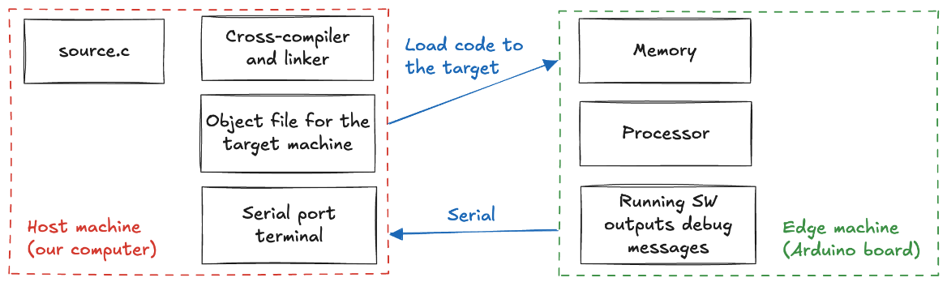
Cross-compilation
Embedded systems very limited resourse makes impossible to perform standard code compilation directly on the device
no compiler or linker available to run on these devices
We need a different machine (host) to compile the source code into a machine language that is executable on the embedded system (target)
We use our computer as the host machine, the Arduino IDE serves as the cross-compiler, and the compiled code is then transferred to the board via a USB connection.

Slide 14
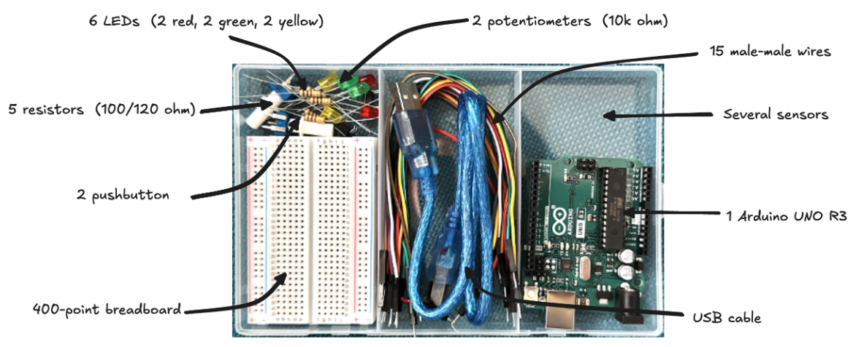
Makers Kit

Slide 15
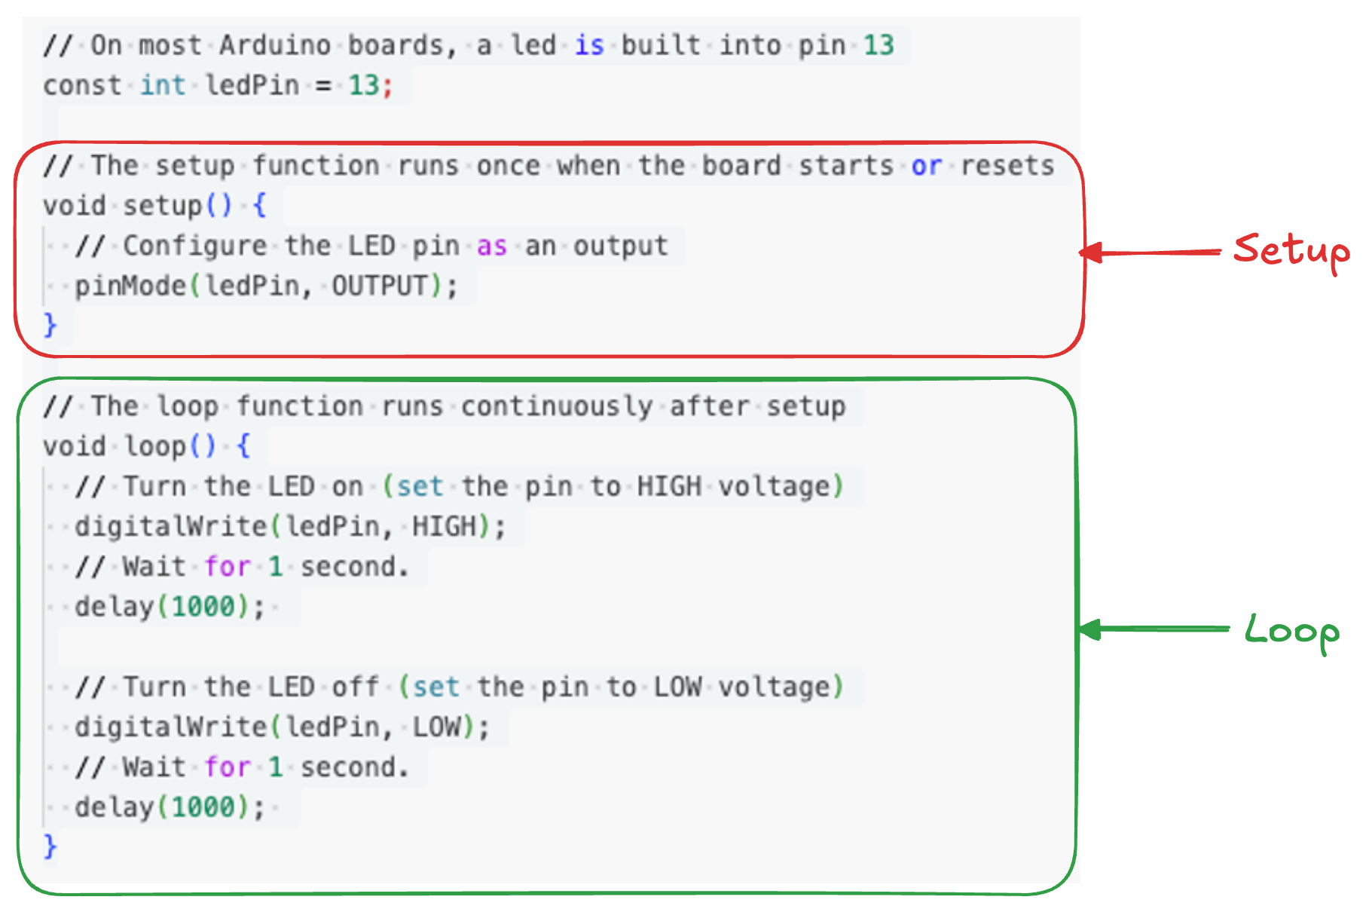
Hello World!
The first Arduino sketch is typically a simple program called "Blink," often referred to as the “hello world” of physical computing
See 01.Blink.ino sketch

Slide 16
Data type, Selection, Repetition and Function
We use standard C data types to define variables and store values:
Integers: used to store whole numbers
Floats: used to store decimal numbers with floating-point precision
Truncation: 02.Integers.ino sketch
Round-off error: 03.Floatingpoint.ino sketch
Support of serial communication for debugging
Initialize Serial.begin()
Serial.print() to send data to the serial monitor
Supports common control structures :
Selection (if statement): used to make decisions based on conditions.
Repetition (loops)
for loop: repeats a block of code a specified number of times
while loop: continues to execute as long as a condition remains true
see 04.Repetition.ino sketch
Functions are a powerful way to organize and reuse code
Encapsulate details of a task, break program into smaller blocks
See 05.Function.ino sketch

Slide 17
Interrupts
A way for a microcontroller to temporarily stop what it is doing to handle an event
the currently executing program is paused
an ISR (Interrupt Service Routine) is executed
then the main loop continues
For example, detect a button press, even if main program is busy with other tasks
26 different interrupts on an Arduino Uno
1 Reset; 2 External Interrupt Request 0 (pin D2); 3 External Interrupt Request 1 (pin D3); 4 Pin Change Interrupt Request 0 (pins D8 to D13),…
When would you use one?
interrupts can detect brief pulses on input pins, polling may miss the pulse while you are doing other calculations
useful for waking a sleeping processor
can be generated at a fixed interval for repetitive processing
…

Slide 18
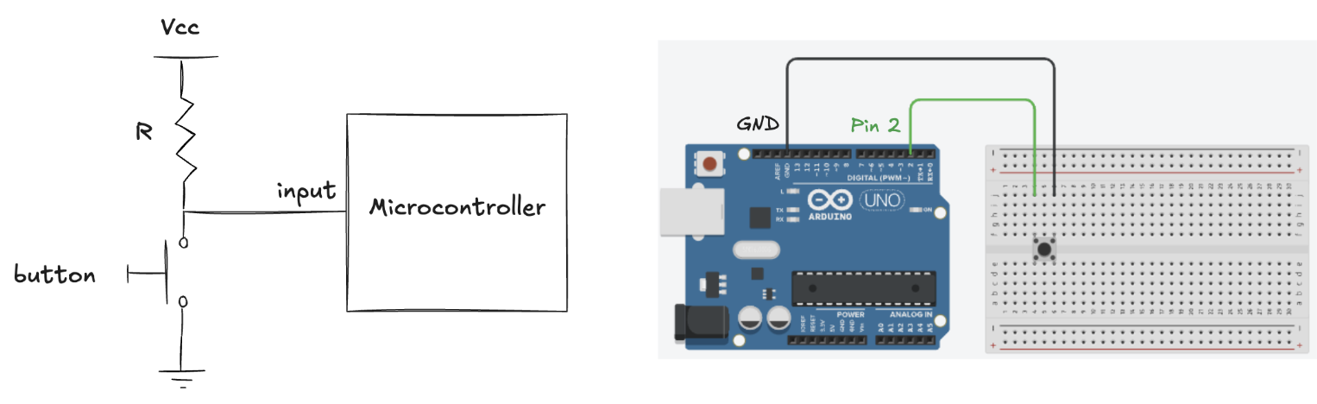
Polling a button
A program where a pushbutton is used as input
good Human-Machine Interface requires to acknowledge the user as soon as possible (e.g. with a led)
suppose we must handle other stuff in the loop that takes a long time (e.g. 1/4 of a second)
Polling will miss inputs occasionally
See 06.NoInterrupt.ino sketch
Potential solution:
split up the “handleOtherStuff” and call “handleSW" more times
still has issues: the shorter the pulse, the more often we need poll

Slide 19
Interrupt solution
By using an interrupt, we can immediately respond to the button press
attachInterrupt (interrupt, function, mode)
interrupt: number of interrupt 0 (pin2) or 1 (pin 3)
function: the function to call when the interrupt occurs
mode: defines when the interrupt should be triggered
LOW, CHANGE, RISING, FALLING
See 07.Interrupt.ino sketch
Result: the code is now responsive!
the code can loop (and delaying)
when the button pulls pin2 low, the micro generates an interrupt
interrupts the main loop, saves the state, calls handleSW, restores the state, and resumes the loop
ISR should be kept short
other interrupts are disabled when the ISR is called
do not call millis() or delay() or Serial or …

Slide 20
Volatile variable
Often, we need to know what is going during interrupt
How do we share information between loop() and ISR?
Volatile variable
Mark variables that may change outside the normal program flow
like an ISR
The compiler reads the variable from memory each time it uses it rather than saving it in a register
We can share a volatile variable to count the number of button press
See 08.NoDebouncing.ino sketch
each time the button pin changes, count variable is incremented
what do you expect to see if the button is pressed and released three times?
Bouncing: the interrupt might be triggered multiple times for a single button press

Slide 21
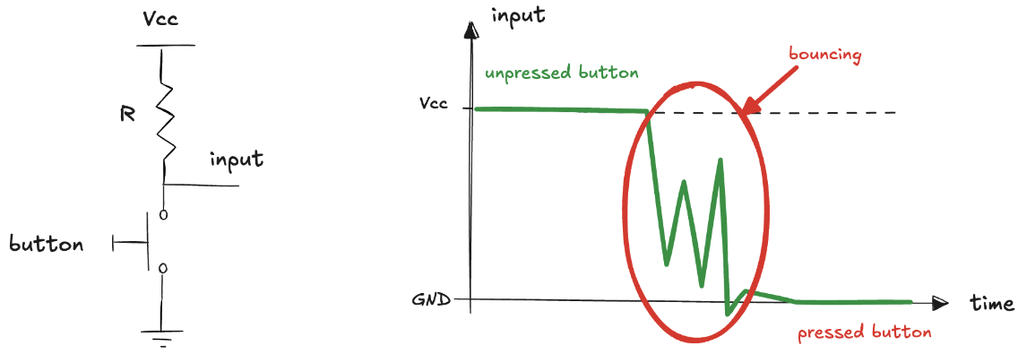
Debouncing
When a mechanism moves, it doesn’t do instantaneously
the mechanism performs some oscillations
if we try to read the button state at that time, the result will be random
Hardware solution
Extra circuit to get rid of the oscillations
Doesn’t occupy the microcontroller, but requires additional components
Software solution
Delaying acceptance of button press until transient has passed
See 09.Debouncing.ino sketch

Slide 22
Serial Communication
To send and receive text and data, we can use the serial communication interface
transmit information from the micro to any serial device
and from serial device to the micro
We need to specify the desired communication speed (baud rate)
Serial.begin(9600)
9600 baud: the number of symbols transmitted per second
We must use the same speed for the sending side and the receiving side
or we will see gibberish (or nothing at all) on the screen
We can display text or numbers
Serial.print("The number is ")
Serial.println(number)
We can also define the format as decimal values, hexadecimal, etc…
Serial.println(number, HEX)
Serial.println(number, BIN)

Slide 23
Receiving serial data
To receive data on Arduino from a serial device
to react to commands or data sent from external world
Check to see if at least one character is available
Serial.available()
Returns the number of characters in the serial buffer
Then, we can read the value received
Serial.read()
Retrieve the next byte from the buffer
For example, receiving numbers involves accumulating characters
See 10.SerialReceive.ino sketch
Controls blink rate of a led based on numeric input received over the serial connection

Slide 24
Sending Multiple Text Fields
Transmit multiple pieces of data (fields) from the micro
sensor readings for temperature, humidity, and pressure
Define the data clearly and format it in a structured way
A common method is to use a comma-separated format
A unique header to indicate the start of the message
distinct, ensuring it does not appear within fields
A consistent delimiter (e.g., commas) to separate the fields
to ensure proper parsing on the receiving side
From the receiving side, the data must be parsed
read the serial buffer and extract fields based on delimiter
we can use Processing (https://processing.org)
open-source development tool (Java based)
useful to "talk" with Arduino
For example, temperature, humidity, and pressure readings can be sent in a comma-separated format with 'H' as the header
See 11.CommaDelimitedOutput.ino sketch:

Slide 25
Receiving Multiple Text Fields
To receive a message containing multiple fields it is necessary to parse the incoming serial data
an identifier for a specific device (e.g., a motor or actuator)
and a corresponding value (e.g., speed to set it to)
The message should follow a structured format as before
Check for incoming data to read
Read message, collecting characters until it is complete
Split message into fields, using the designated delimiter
Extract values from fields and perform the corresponding task
e.g. set the speed of the specified motor
Example:
Receive a message containing three numeric fields separated by commas and store the values into an array
The expected format of the message is 12,345,678
See 12.SerialReceiveMultipleFields.ino sketch

Slide 26
Sending Binary Data
In addition to exchange textual information (formatted as characters), it is possible to exchange data in binary format
to pass information with the fewest number of bytes
Example:
lowByte() and highByte() functions can split a 16-bit integer into two 8-bit segments
Bytes are sent over the serial connection
Receiver reads the header, the low and high bytes and reconstructs original value
See 13.SendBinary.ino sketch and processing code
Binary formats require fewer bytes to represent the same information compared to text-based formats
An integer occupies 2 bytes in binary, while its textual representation (e.g., "12345") requires significantly more bytes
Compactness reduces transmission time and bandwidth usage
Eliminates the need for parsing numeric values from text
However, it is not human-readable
debugging and manual inspection are challenging

Slide 27
Receiving Binary Data
Sending binary data from a serial device to a micro is similar
ensure the data format is correctly understood by the micro firmware
binary data might represent control commands that the micro needs to process efficiently
Example:
Processing send a message with mouse coordinates
Windows size is set to 200x400 pixels
x-coordinate needs only one byte to be represented
y-coordinate needs two bytes to be represented
See 14.ReceiveBinary.ino sketch
In general
Binary approach is useful for transmitting large amounts of data
or when speed and efficiency are critical
consider the trade-offs between efficiency and readability
binary data requires careful planning and coordination between the sender and receiver to ensure that the data is correctly interpreted

Slide 28
Binary Data issues (1)
Variable size
make sure size of the data is the same on both sides: check the language documentation
there is no problem receiving a 2-byte integer if the receiver expects to get only two bytes
be sure that the sending side does not use values that will overflow the type used by the receiving side
Byte order
make sure the bytes within an int or long are sent in the same order expected by the receiving side
Synchronization
ensure that receiving side can recognize the beginning and end of a message
if we start listening in the middle of a transmission stream, we will not get valid data
this can be achieved by sending a sequence of bytes that won’t occur in the body of a message

Slide 29
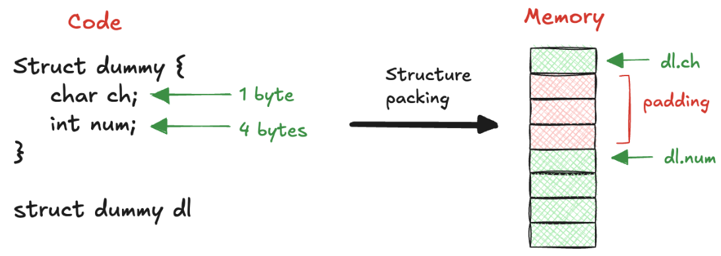
Binary Data issues (2)
Structure packing
make sure the packing is the same on both sides (compiler documentation)
the padding used to align data elements of different sizes in a structure
Flow control
choose a transmission speed that ensures the receiving side can keep up with the sending side
handshake that tells the sending side that the receiver is ready to get more data

Slide 30
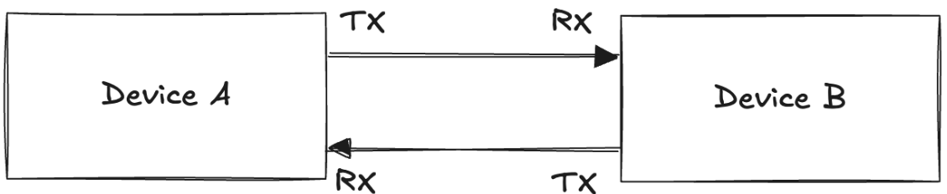
Asynchronous communication
In the example we have seen so far, based on USB protocol and on the Serial library the communication was asynchronous
Data is sent without a shared clock signal
Sender and receiver must agree on a specific data rate and interpret the data based on their internal timing mechanisms
making crucial for both to have precise internal oscillators
Separate wires are used for transmitting (TX) and receiving (RX) data
allowing bidirectional communication
This approach is simple and effective for many applications, but it can be prone to timing errors, especially over long distances or in noisy environments.

Slide 31
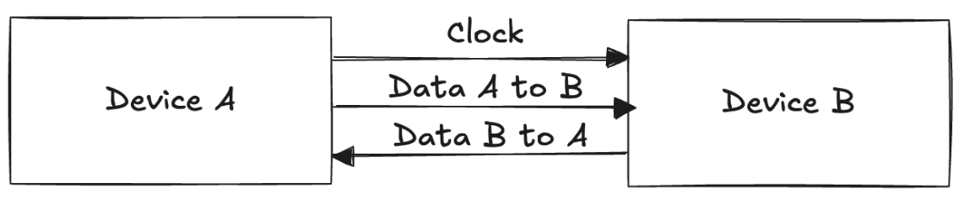
Synchronous communication
An alternative approach is synchronous communication
Devices use a shared clock signal to synchronize data transmission
Eliminates the need for independent timing mechanisms within the devices
The clock acts as a "conductor" guiding the flow of data
Require additional wiring for the clock signal
Increase hardware complexity.
This method offers more reliable data exchange by eliminating timing mismatches ensuring precise synchronization between devices.

Slide 32
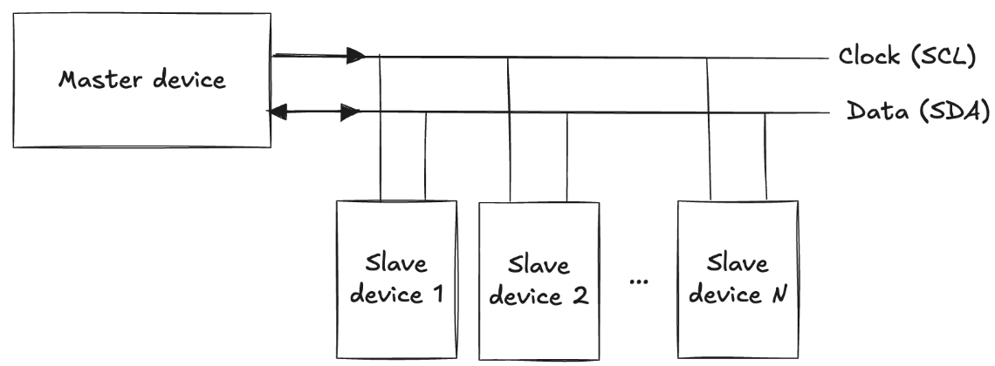
I2C (Inter-Integrated Circuit)
Supports multiple devices on the same bus
Each device has a unique address
Master device controls the communication by generating the clock signal and initiating data transfer
Slave devices respond to commands from the master
The communicate over the shared bus consisting of two wires
For data (SDA: Serial Data Line)
For the clock (SCL: Serial Clock Line)

Slide 33
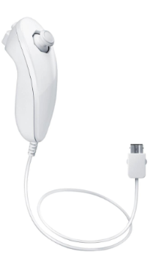
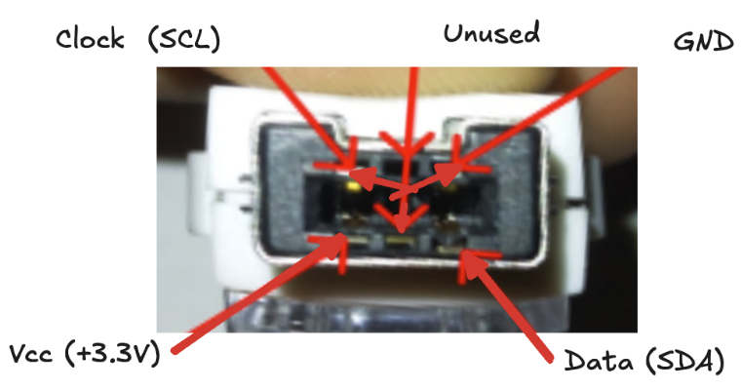
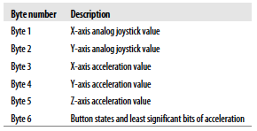
Wii Nunchuck (1)
We can use a Wii Nunchuck as an accelerometers
No official data sheets (reverse engineering)
I2C slave address is 0x52
Communication based on an handshake: bytes 0x40, 0x00
Data request command: byte 0x00
Response: 6 bytes
Coding scheme: data = (reading XOR 0x17) + 0x17

Slide 34
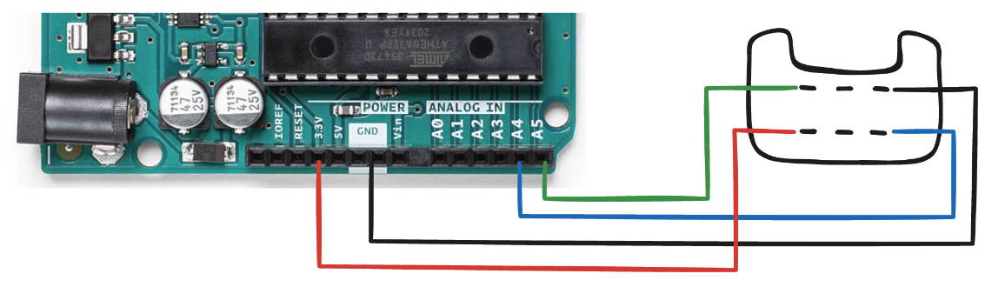
Wii Nunchuck (2)
Arduino Uno supports I2C with pins
Analog Pin A4 is the Serial Data Line (SDA)
Analog Pin A5: Functions as the Serial Clock Line (SCL)
The Wire library abstracts the protocol
begin() intialize the bus in master mode
beginTransmission(address) starts communication with a slave, write(data) sends data, endTransmission() ends the comunication
requestFrom(address, quantity) requests a specified number of bytes from a slave, read() reads the received data byte by byte and available() returns the number of bytes available to read
Example: read data from a Nunchuck and send them to an external device connected on the serial port
See 15.Nunchuck.ino sketch

Slide 35
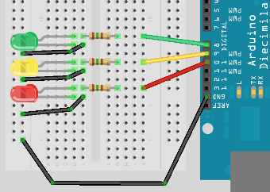
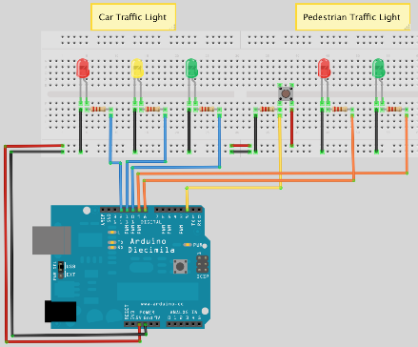
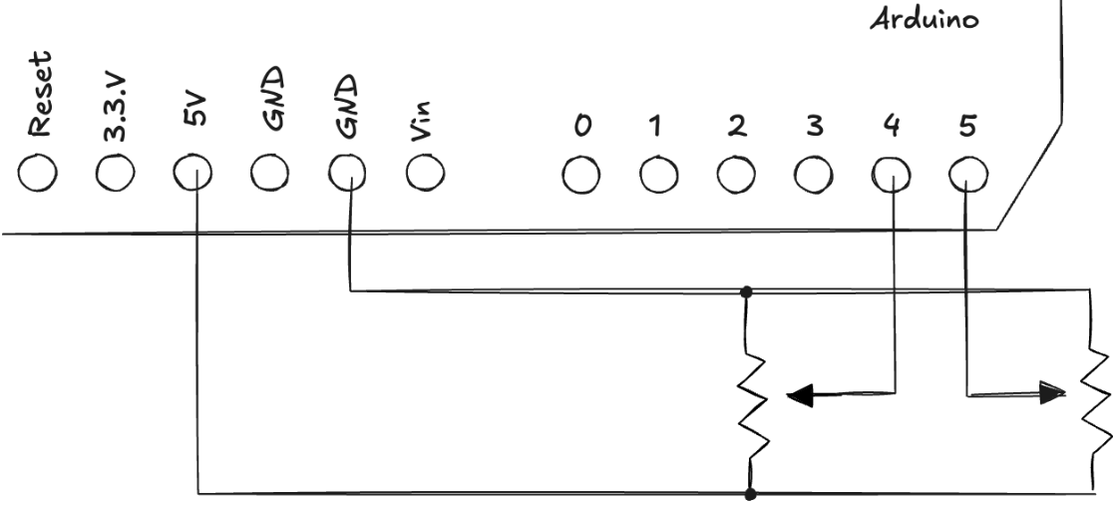
Hands-on Activity
Create a simple traffic light system
The system should alternate between green, yellow, and red lights, simulating the behaviour of a traffic light (16.TrafficLights.ino)
Enhance the traffic light system by adding pedestrian lights and a push button
When the button is pressed, the pedestrian light will turn green, allowing pedestrians to cross safely (17.PedestrianTraffiLights.ino)
Control the computer mouse cursor using two potentiometers
use Processing to receive data and move the mouse cursor using the Robot class, which generates native system input events

